Slide 1
Cryptographic techniques
Dr. o. I. Adelaiye

Slide 2
Introduction

Slide 3


Slide 4
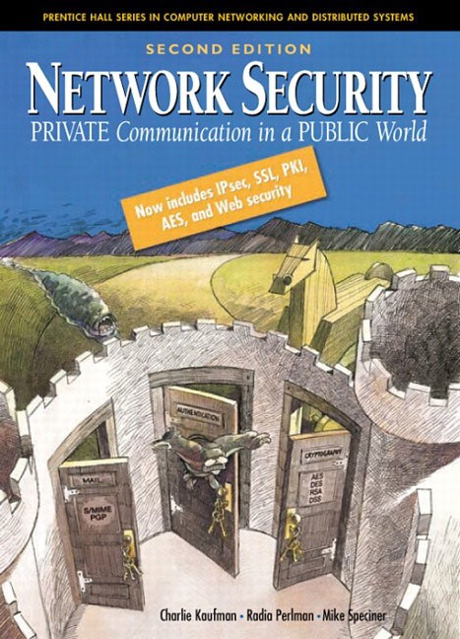

Slide 5
What is Cryptography?
Is a Greek word
𝜅𝜌𝜐𝜋𝜏𝜊 (crypto), secret
𝛾𝜌𝛼𝜙𝜂 (graphy), writing
”The art of mangling information into apparent unintelligibility in a manner allowing a secret method of unmangling”
Allows the transformation of a plaintext (cleartext) into a ciphertext and vice versa
Plaintext →ciphertext = encryption
Ciphertext →plaintext = decryption

Slide 6
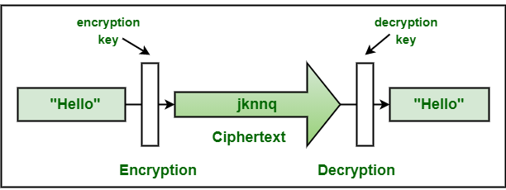
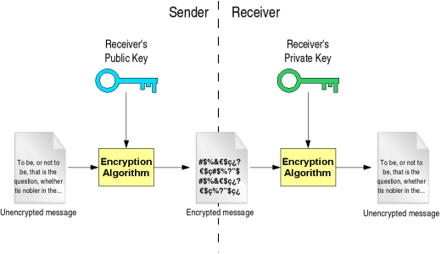

Slide 7
Why Cryptography?
Protects stored data
Protects data in transit
Provides protection against
Data eavesdropping
Tampering with data
Could be easily used for authentication purposes

Slide 8
Any terminology at all?
Suuuuuuuuuuure !
Cryptography
art of creating and using codes to secure transmission of information
Cryptanalysis
art of obtaining original message from ciphertext without access to secret information (key or algorithm itself)
Cryptology
combines cryptography and cryptanalysis

Slide 9
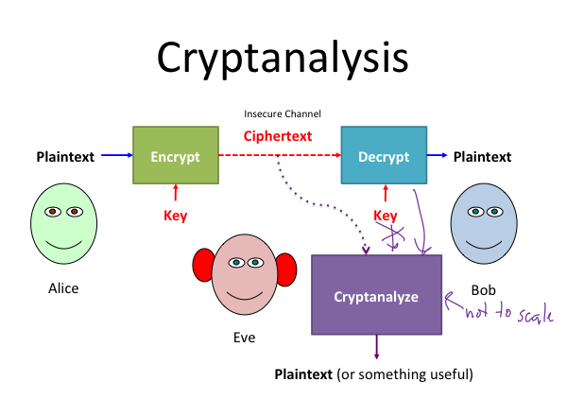

Slide 10
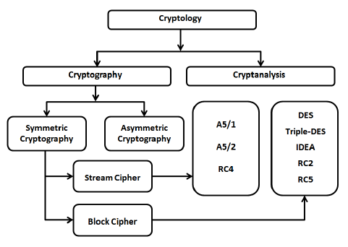
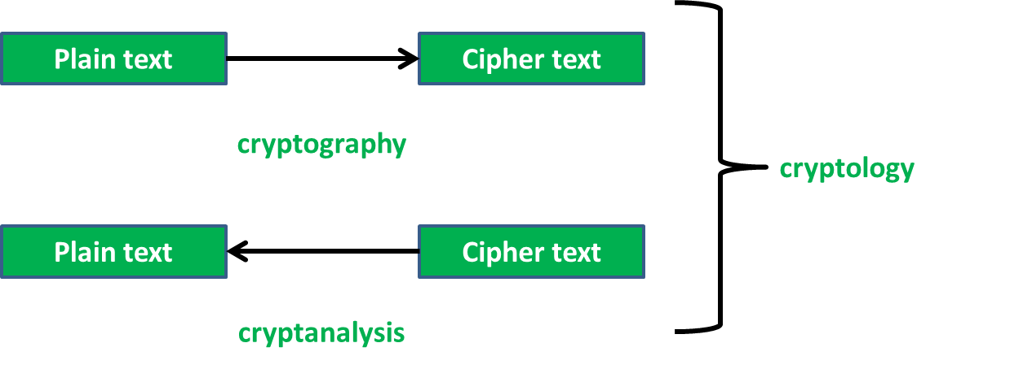

Slide 11
When did it all start?
Julius Caesar (sometime BC) !
A substitution cipher
The Caesar cipher replaces the ith letter by the i+3th letter
CAT becomes FDW
Wraps around to A from Z
Generalised in monoalphabetic ciphers
No restriction (such as i →i+3) on which letter could be assigned to which
E.g. A is encrypted as B, B as D, C as Z, D as A, etc.
26! possible monoalphabetic ciphers (4x1026)
Stronger than Julius Caesar, but would you use it?
NO ! Vulnerable to statistical analysis
Most common English letters?

Slide 12
What happened next?
Vigenere Cipher
Not his
First appeared in Rome in “La cifra del. Sig. Giovan Battista Bellaso”, in 1553
“Le chiffre indéchiffrable” for about 3 centuries
Similar to a Caesar cipher but has a variable shift value
First letter shifted by 5, second by 17, third by 11
5, 17 and 11 are defined by a secret
The values range is 0 to 25 (A to Z): A is 0, Z is 25

Slide 13
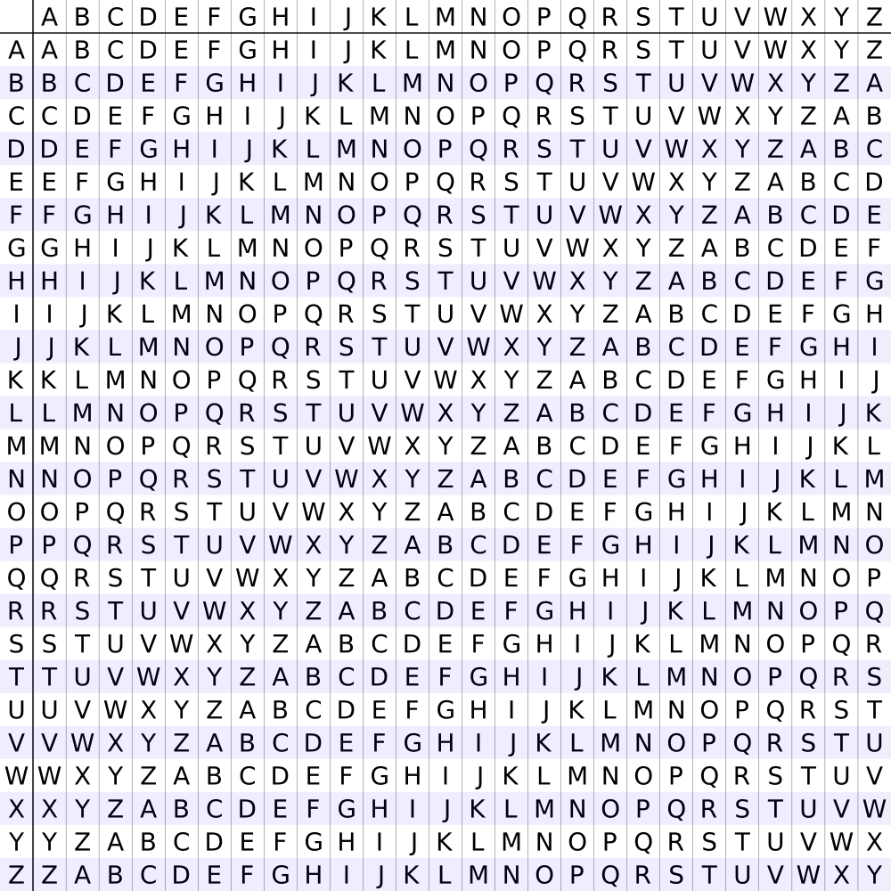
What happened next?
Vigenere Cipher
If the message to be encrypted is longer than the key, then the key is repeated
Example: Encrypt HACKNOW using CAT
Repeat key to match message’s length
CATCATC
The table shows how to encrypt
H row, C column = encrypted H = ?
Decipher by going to row C and look for “?” inside the row (not in the column index), the corresponding column index is the cleartext

Slide 14

BREAKING A CRYPTOGRAPHIC ALGORITHM

Slide 15
Should cryptographic algorithms be kept secret?
Keeping an algorithm secret prevents crackers from knowing it ➔they cannot break it
Security through obscurity
Difficult in practice
Each time you use the algorithm with someone, they need to learn it (and might leak it?)
If it is implemented in some hardware, reverse-engineering it could reveal the algorithm

Slide 16
Should cryptographic algorithms be kept secret?
Making an algorithm available makes it possible for crackers to do all tests on the algorithm
And all the good guys too
Asa a good guy finds a loophole, she warns people
Fundamental Tenet of Cryptography
“If lots of smart people failed to solve a problem, then it probably won't be solved (soon)”
Nowadays, most of commercial algorithms are public, whereas some military algorithms are kept secret

Slide 17
Should cryptographic algorithms be kept secret?
Kirchhoff's principle
A cryptographic algorithm must not be required to be secret, and it must be able to fall into the hands of the enemy without inconvenience
Its key must be communicable and retainable without the help of written notes, and changeable or modifiable at the will of the correspondents
The only secret in the system should be the key

Slide 18
How Difficult is it to Find a Key?
Assume you are using an algorithm with a 16 bit key
2¹⁶ (=65536) possible keys
If a computer can test 100 keys/sec, then it will take a bit less than 11 minutes to try all of them
brute-force
And, in average, half that time to find the right key
This time doubles for each added bit (0 or 1)
For a 24 bit key, the same computer will need almost 20 months to try all combinations
In practice, computers are much faster, but keys are much longer too !
We would say that it is computationally infeasible to brute-force a cryptographic algorithm if it required an unreasonable amount of time using the most powerful computers

Slide 19
How Difficult is it to Find a Key?
Note that if the keys are chosen and used by humans, then they have limited choices
24 bit key is a 3 character key
Say for example that the used characters are upper and lower case and numerals
26+26+10 = 62 possibilities for each character
62³(=238328) possible keys in all
Takes less than an hour to try all combinations !
Nowadays, 280 possible combinations are considered feasible

Slide 20
How to Break a Crypto Algorithm?
Three typical attacks
1.Ciphertext only
Attacker has access to encrypted messages
The attacker has to try possible keys in turn until one works
The attacker has to be able to recognize that a key actually works
Hence the name recognizable plaintext attack
Problem when dealing with a cipher text that can be decrypted in several ways
Should have many samples
Does not occur with modern crypto algorithms (too randomised outputs)

Slide 21
How to Break a Crypto Algorithm?
Three typical attacks
2. Known Plaintext
The attacker obtained pairs of plain and cipher texts
Could be because the meaning of the ciphertext was revealed
Attack? Yes, no
Next target?
Should prevent attackers from getting those pairs
Adding a sequence number

Slide 22
How to Break a Crypto Algorithm?
Three typical attacks
3.Chosen Plaintext
The attacker can choose the plaintext and make the system encrypt it !
Real life example: WEP
In WEP, the access point can send random numbers to the station (e.g. laptop) and the station encrypts and returns it
An attacker could pretend to be the access point
Same if there are only few possible meanings of the ciphertext
E.g. YES or NO

Slide 23
TYPES OF CRYPTOGRAPHIC TECHNIQUES

Slide 24
Do all Crypto Algorithms Work the Same Way?
Three types of crypto Techniques
1.Secret key/SYMMETRIC algorithms
Most intuitive: same key for encryption and decryption
Also known as Symmetric Cryptography
Many uses in secure systems, one of the most obvious ones is confidentiality
The two communication parties have to find a way of sharing the key before communicating

Slide 25
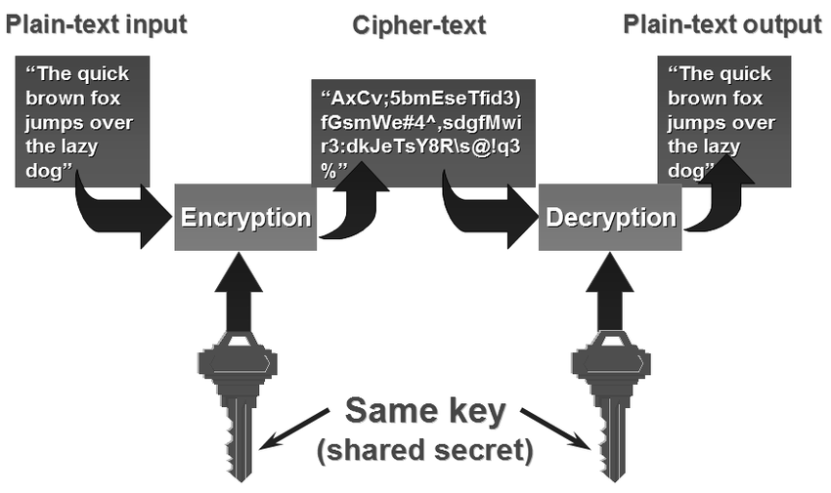

Slide 26
Do all Crypto Algorithms Work the Same Way?
Three types of crypto Techniques
2.Public key/ ASYMMETRIC algorithms
Keys work in pairs
When a key is used to encrypt, only the other one can decrypt
Can encrypt with either; different uses
Also known as Asymmetric Cryptography
Typically one key is kept secret (private key), the other one is made public (public key)
Many uses in secure systems, one of the most obvious ones is authentication
The two communication parties have to find a way of sharing public key(s?) before communicating

Slide 27
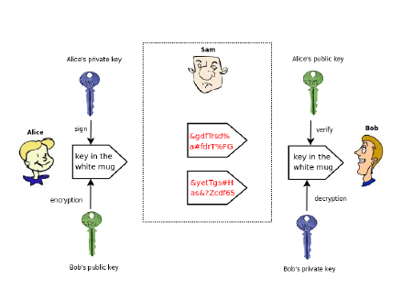

Slide 28
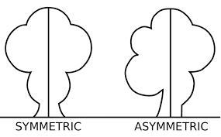

Slide 29
Do all Crypto Algorithms Work the Same Way?
Three types of crypto TEchniques
3.Hash algorithms
A one-way transformation
If h is a hash function such that y=(h), then it is computationally infeasible for a user who has h and y to find x(or an x’ ?such that h(x’)=y)
Gives a fixed length output, whatever the input size is
MD5’s is 128, SHA-1’s is 160
The output is sometimes called hash, digest or checksum
Many uses in secure systems, one of the most common ones is digital signatures

Slide 30
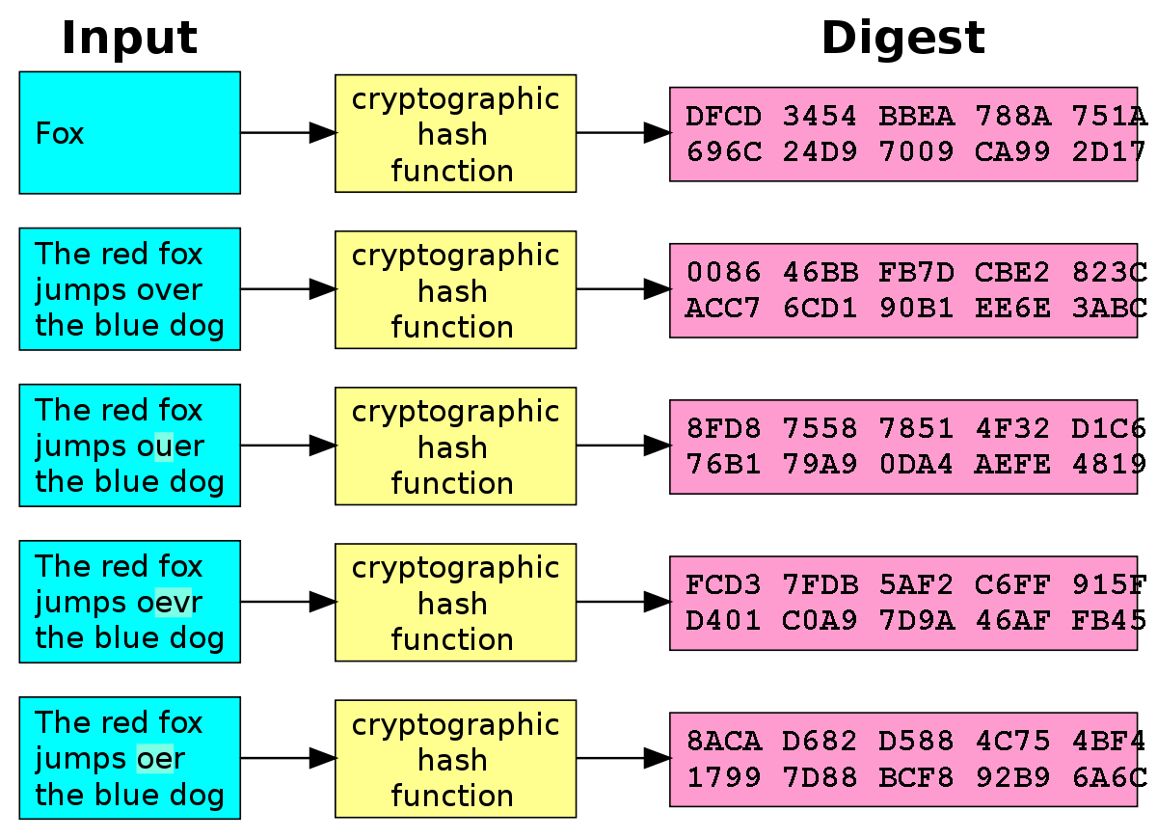

Slide 31
END

